Slide 1
MEE 613
ENERGY SYSTEMS ASSESSMENT AND MODELING

Slide 2
BILLING STATEMENT VS COMPUTED ENERGY CONSUMPTION
A sample billing statement from the utility company is being referred for the “real” energy consumption of the household and it is compared with the energy consumption that was computed using an ideal solution.
The household utilizes appliances/devices of refrigerator(100watts rating), 1 fluorescent lamp(10watts rating), 24” TV(120watts rating), 2 incandescent bulbs(10watts rating each) ONLY.
Discussions are done.

Slide 3
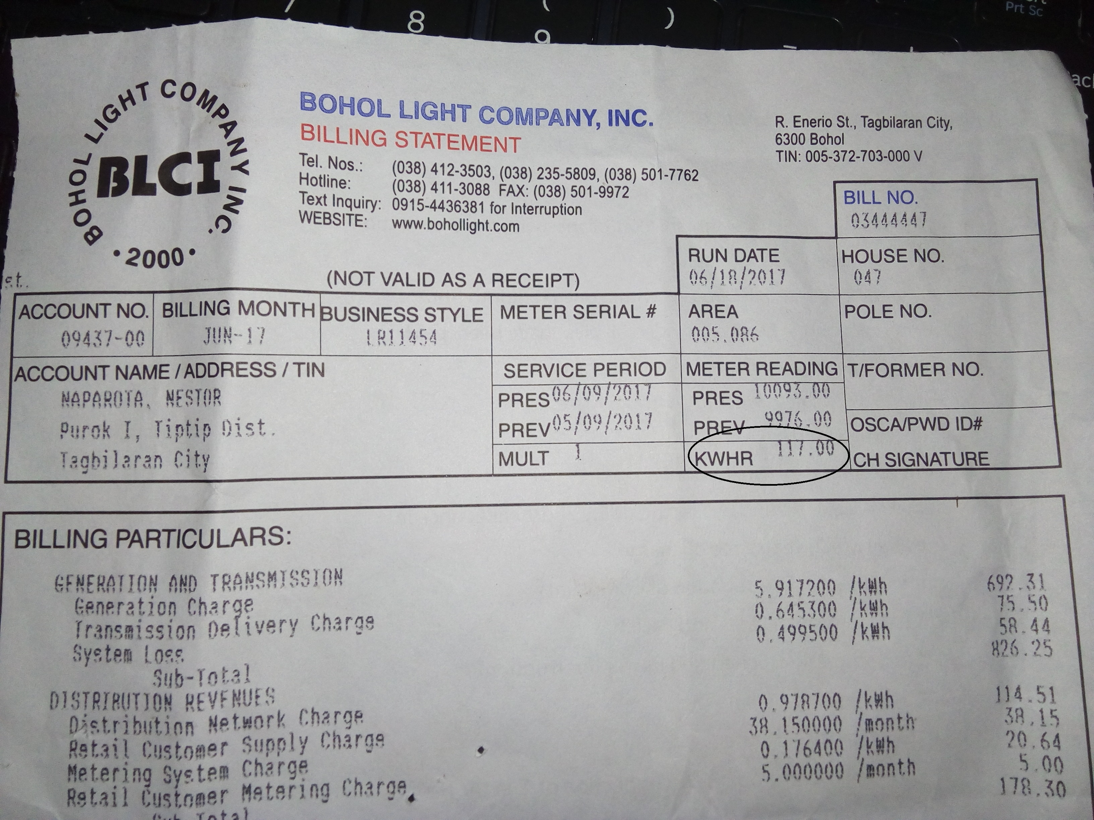
SAMPLE ELECTRIC BILLING STATEMENT
THIS MONTH’S ENERGY CONSUMPTION IS 117 KWH

Slide 4
POWER USAGE THROUGHOUT THE DAY
TIME | POWER
00:00-05:00 | 100 Watts
05:00-07:00 | 110 Watts
07:00-11:00 | 220 Watts
11:00-12:00 | 100 Watts
12:00-15:00 | 220 Watts
15:00-18:00 | 100 Watts
18:00-23:00 | 240 Watts
23:00-00:00 | 100 Watts

Slide 5
GRAPH OF DAILY POWER USAGE

Slide 6
GRAPH OF DAILY ENERGY USAGE

Slide 7
Referring to the previous graph, the total energy consumption of an entire day is 3960 watt-hour
Assuming uniform daily usage for the entire month and having 30 days in a month, we can get 3960x30=118,800 watt-hour or 118.8 kilowatt-hour

Slide 8
DISCUSSION
The computed energy consumption which is 118.8 kWh differ with the expected energy consumption which is 117 kWh, it differs with almost 2 kWh.
The difference or the closeness from the expected value and the computed one can be associated with the facts:
The length of time considered for the appliances/devices utilization are just assumptions.
The energy consumption every day is assumed to be uniform throughout the whole month.

Slide 9
Thank You!
Prepared By:
Ivan John Naparota
Master of Science in Electrical Engineering

